Slide 1


Tourism in Amsterdam
Ezgi Berber

Slide 2
Background and Problem Description
Amsterdam is a city with a population roughly 1,5 million. Meantime, the number of tourists that visit Amsterdam each year reaches to roughly ten times its population with 15.9 million daily visitors and 8.3 million overnight visitors [1]. As the volume of tourists that visit Amsterdam keep on growing, the possibilities for accommodation increases as well as number of other establishments targeting tourists.
With growing numbers of restaurants, bars and coffee-shops, there are concerns that Amsterdam is becoming a victim of over-tourism. Besides loosing authenticity of Amsterdam, there are concerns with regards to scarcity of living spaces for locals. Limited number of accommodation options lead to competition between regular and tourist accommodation while more and more essential shops leave their place to tourist shops.

Slide 3
Data Description
Data on Neighbourhoods of Amsterdam:
GeoJson file containing different neighbourhoods [2].
Neighbourhoods.csv: csv file containing latitude and longitude data for center point of each neighbourhood. The latitude and longitude data has been driven from Google Maps by selecting Ouder-en-Kind Stichting’s office location for each neighbourhood [3].
Data on Venues:
Foursquare API [4]
Data on AirBnB listings:
Listings.csv : csv file containing names, prices, neighbourhood, lat&long data for each AirBnB listing in Amsterdam [2].

Slide 4
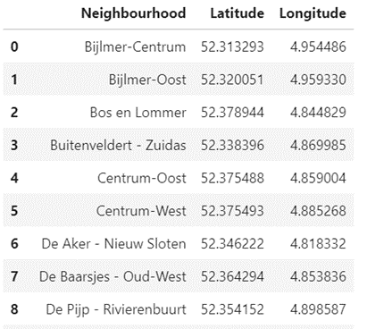
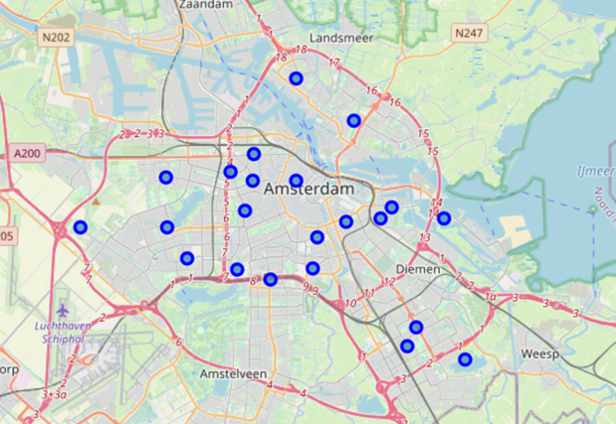
Neighbourhoods in Amsterdam
Let’s start by familiarizing with Amsterdam’s Neighbourhoods by plotting them with folium

Slide 5
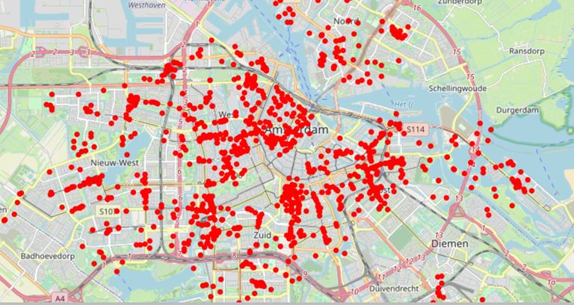
Venues in Amsterdam
Venues in Amsterdam by using Foursquare API and plotting the venues with folium*.
*Criteria: radius=1000m from center
Limit=100 vernues/neighborhoods

Slide 6
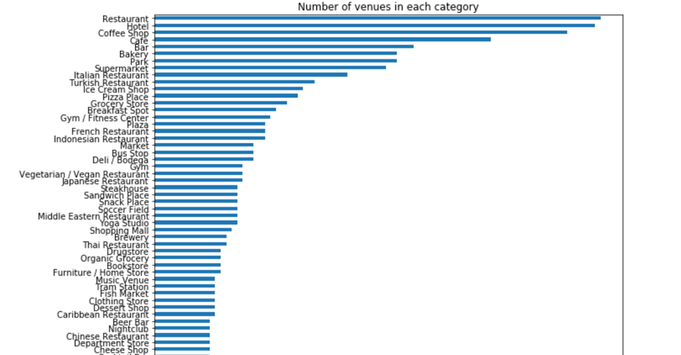
Most common venue categories
Restaurants are the most common venues in Amsterdam by far. Even without merging different categories (such as Japanese restaurants, Turkish restaurants etc.)
Hotels, Coffee shops and Bars follow restaurants on popularity

Slide 7
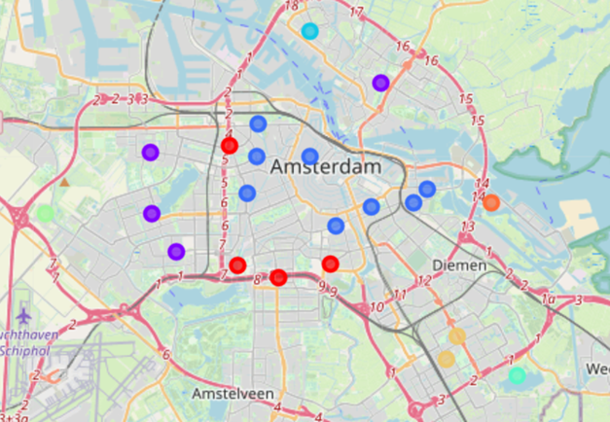
Neighbourhood Clusters
Method: K-means clusters based on most common venue categories in each neighbourhood.
Cluster 2 (marked in blue), stands out with regards to dominance of coffee shops, hotels, bars and restaurants.

Slide 8
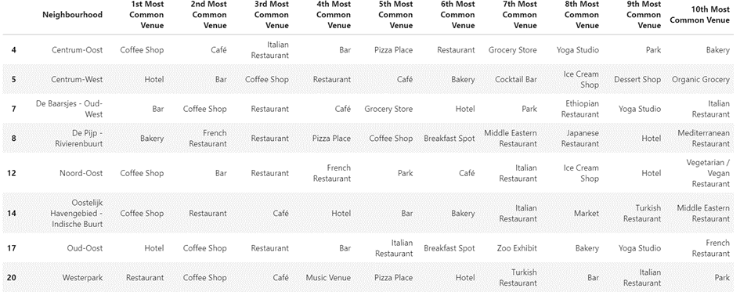
A more detailed look into Cluster 2

Slide 9
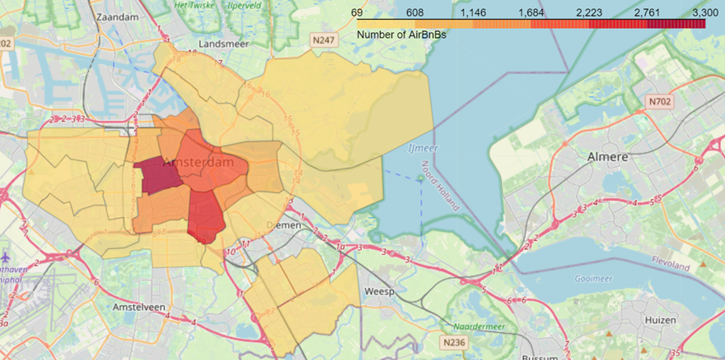
Airbnbs in each neighborhood
De Baarsjes – Oud West has the highest number of airbnbs. The number of Airbnb listings in this neighborhood reaches 3268

Slide 10
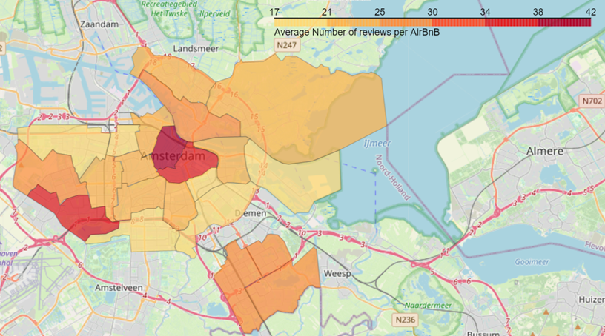
Most reviewed Airbnbs
Airbnb’s in Centrum west, Centrum-oost and De Aker-Nieuw Sloten get the more reviewes on average

Slide 11
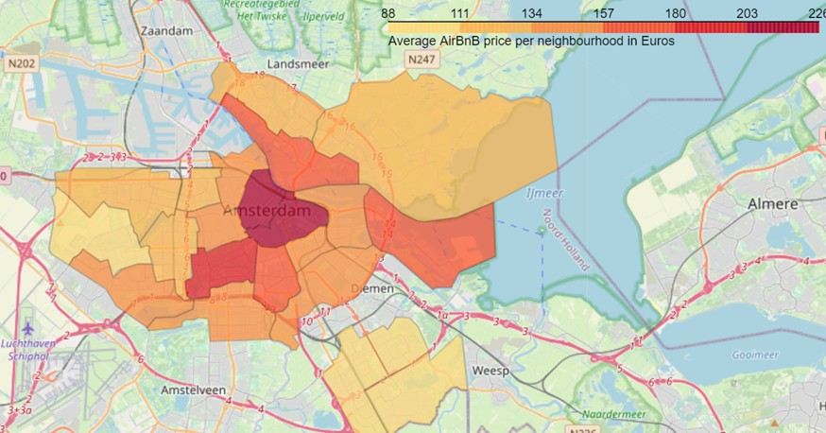
Average Price of Airbnb
Centrum West and Centrum Oost remain to be more expensive for Airbnb accommodation.

Slide 12
Observations
There is a large number of venues that are aimed at tourists in Amsterdam. This shows itself clearly in fig.5.
By clustering neighbourhoods, we see that the neighbourhoods in Central Amsterdam form a cluster. Compared to different clusters this cluster has a higher concentration of coffee shops, hotels and bars.
From figures 11 and 12 that Central Amsterdam remains attractive for visitors even though average Airbnb prices are higher compared to other neighbourhoods.
Meanwhile De Baarsjes – Oud West has the highest numbers of airbnb listings while average price and number reviews remain lower.

Slide 13
Discussion
For municipality of Amsterdam there could be different strategies to limit over-tourism. One of them could be limiting licenses for Airbnb listings in each neighborhood. Another could be creating a tourist designated area where a few neighbourhoods are kept as a tourist destination while others offer limited tourist-venues or accommodation.
The neighborhood, De Baarsjes – Oud West has the most number of airbnbs while still being cheaper and less popular than its neighbour Centrum-West. Therefore it could be a critical test case for applying strategies to overcome over-tourism.

Slide 14
References
[1] https://www.amsterdam.info/basics/figures/
[2] http://insideairbnb.com/get-the-data.html
[3] https://maps.google.com
[4] https://developer.foursquare.com/docs/api-reference/venues/details/

Slide 15


Thank you!

